Slide 1
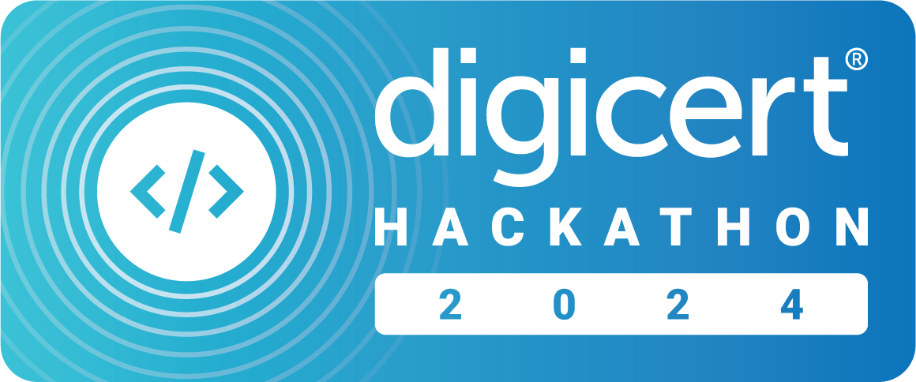

Azure Devops ci/cd integration app
5
Evans Ejike
Notes:
Hello, and welcome to my Hackathon project. Today, I’ll be presenting a solution that streamlines the integration between STM/Keylocker and Azure DevOps for seamless CI/CD signing.

Slide 2
[Azure Devops ci/cd integration app]: Overview
Current Challenge in Secure Code Signing
How Our Solution Simplifies the Process
Seamless Integration with Azure DevOps
Secure, Automated, and Scalable Signing
Notes:
Imagine you're a DevOps engineer trying to integrate secure code signing into your CI/CD pipelines. You want to use DigiCert’s Software Trust Manager or KeyLocker, but you hit a roadblock—there’s no direct integration with Azure DevOps or other major CI/CD platforms, unless you use our plugin or script. The process is complex, time-consuming, and requires deep expertise in security and DevOps. This is a problem I’ve encountered repeatedly as a Solution Engineer, with customers frequently asking for guidance on how to implement this seamlessly.
Today, I’m excited to introduce a game-changing solution that eliminates this pain point: the STM & KeyLocker CI/CD Integration App.

Slide 3
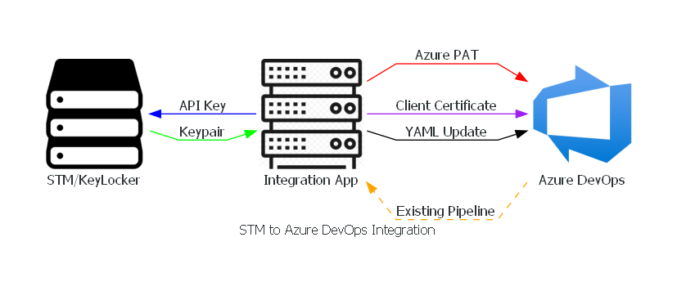
Demo

Slide 4

Azure Devops ci/cd integration app: Business Value
Notes:
Why does this matter for DigiCert and our customers?
Right now, no other service offers a streamlined integration with Azure DevOps CI/CD platforms. Competitors like Azure DevOps and AWS KMS provide pieces of the puzzle but lack an easy-to-use, direct integration that this App offers.
By offering this app, we remove a major adoption barrier for STM and KeyLocker, making it a no-brainer for customers who want security without complexity. This gives DigiCert a competitive edge—driving STM and KeyLocker adoption, increasing customer retention, and positioning us as the go-to choice for secure software delivery.

